Slide 1
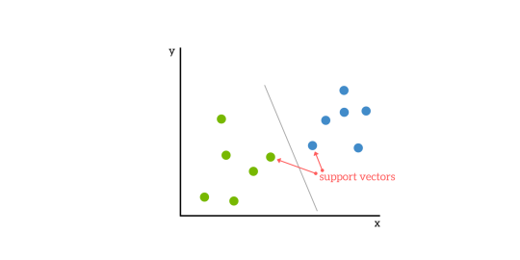
BASICS OF SVM
A Support Vector Machine (SVM) is a supervised machine learning algorithm that can be employed for both classification and regression purposes. SVMs are more commonly used in classification problems and as such, this is what we will focus on in this post.
SVMs are based on the idea of finding a hyperplane that best divides a dataset into two classes, as shown in the image below.

Slide 2
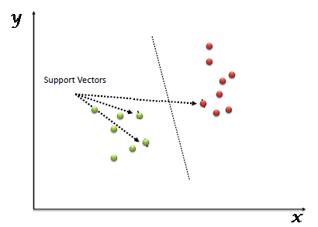
What is Support Vector Machine?
“Support Vector Machine” (SVM) is a supervised machine learning algorithm which can be used for both classification or regression challenges. However, it is mostly used in classification problems. In the SVM algorithm, we plot each data item as a point in n-dimensional space (where n is number of features you have) with the value of each feature being the value of a particular coordinate. Then, we perform classification by finding the hyper-plane that differentiates the two classes very well Support Vectors are simply the co-ordinates of individual observation. The SVM classifier is a frontier which best segregates the two classes (hyper-plane/ line).

Slide 3
Support Vectors
Support vectors are the data points nearest to the hyperplane, the points of a data set that, if removed, would alter the position of the dividing hyperplane. Because of this, they can be considered the critical elements of a data set.
What is a hyperplane?
As a simple example, for a classification task with only two features (like the image above), you can think of a hyperplane as a line that linearly separates and classifies a set of data.
Intuitively, the further from the hyperplane our data points lie, the more confident we are that they have been correctly classified. We therefore want our data points to be as far away from the hyperplane as possible, while still being on the correct side of it.
So when new testing data is added, whatever side of the hyperplane it lands will decide the class that we assign to it.

Slide 4
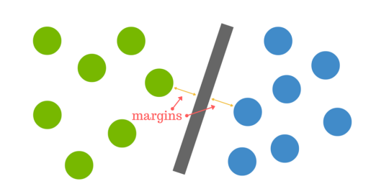
How do we find the right hyperplane?
The distance between the hyperplane and the nearest data point from either set is known as the margin. The goal is to choose a hyperplane with the greatest possible margin between the hyperplane and any point within the training set, giving a greater chance of new data being classified correctly.

Slide 5
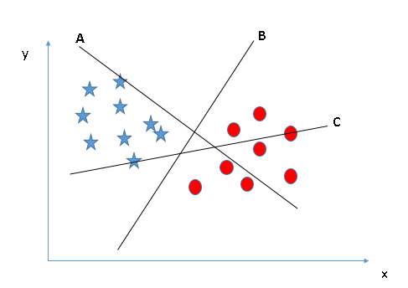
How does it work?
Above, we got accustomed to the process of segregating the two classes with a hyper-plane. Now the burning question is “How can we identify the right hyper-plane?”
Identify the right hyper-plane (Scenario-1): Here, we have three hyper-planes (A, B and C). Now, identify the right hyper-plane to classify star and circle. You need to remember a thumb rule to identify the right hyper-plane: “Select the hyper-plane which segregates the two classes better”. In this scenario, hyper-plane “B” has excellently performed this job

Slide 6
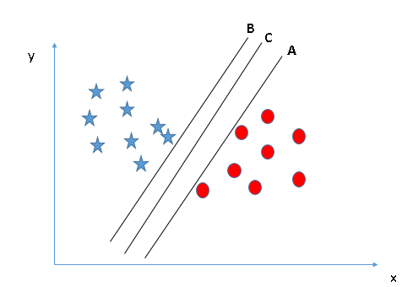
Identify the right hyper-plane (Scenario-2): Here, we have three hyper-planes (A, B and C) and all are segregating the classes well. Now, How can we identify the right hyper-plane? Here, maximizing the distances between nearest data point (either class) and hyper-plane will help us to decide the right hyper-plane. This distance is called as Margin.

Slide 7
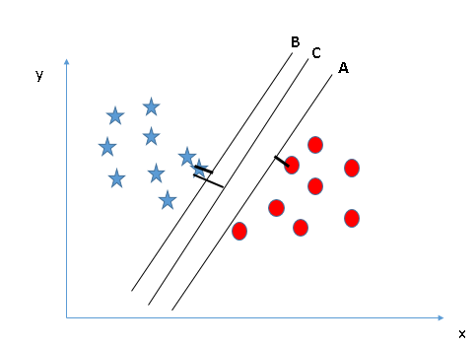
Let’s look at the below snapshot: Below you can see that the margin for hyper-plane C is high as compared to both A and B. Hence, we name the right hyper-plane as C. Another lightning reason for selecting the hyper-plane with higher margin is robustness. If we select a hyper-plane having low margin then there is high chance of miss-classification.

Slide 8
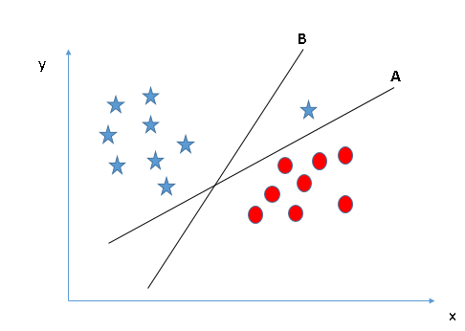
Identify the right hyper-plane (Scenario-3):Hint: Use the rules as discussed in previous section to identify the right hyper-planeSome of you may have selected the hyper-plane B as it has higher margin compared to A. But, here is the catch, SVM selects the hyper-plane which classifies the classes accurately prior to maximizing margin. Here, hyper-plane B has a classification error and A has classified all correctly. Therefore, the right hyper-plane is A.

Slide 9
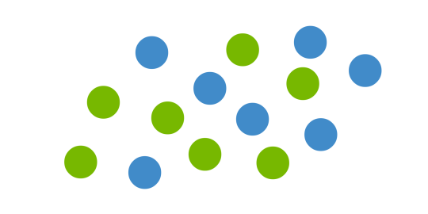
But what happens when there is no clear hyperplane?
This is where it can get tricky. Data is rarely ever as clean as our simple example above. A dataset will often look more like the jumbled balls below which represent a linearly non separable dataset.

Slide 10
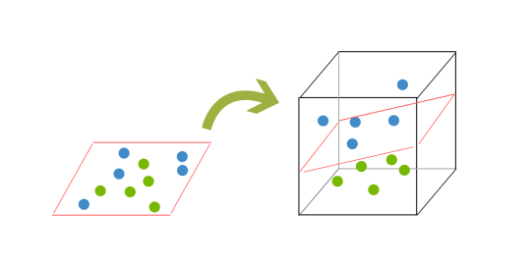
In order to classify a dataset like the one above it’s necessary to move away from a 2d view of the data to a 3d view. Explaining this is easiest with another simplified example. Imagine that our two sets of colored balls above are sitting on a sheet and this sheet is lifted suddenly, launching the balls into the air. While the balls are up in the air, you use the sheet to separate them. This ‘lifting’ of the balls represents the mapping of data into a higher dimension. Because we are now in three dimensions, our hyperplane can no longer be a line. It must now be a plane as shown in the example above. The idea is that the data will continue to be mapped into higher and higher dimensions until a hyperplane can be formed to segregate it.

Slide 11
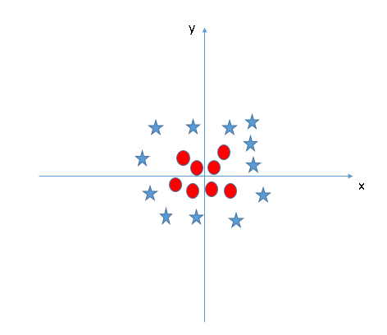
Find the hyper-plane to segregate to classes (Scenario-5): In the scenario below, we can’t have linear hyper-plane between the two classes, so how does SVM classify these two classes? Till now, we have only looked at the linear hyper-plane.

Slide 12
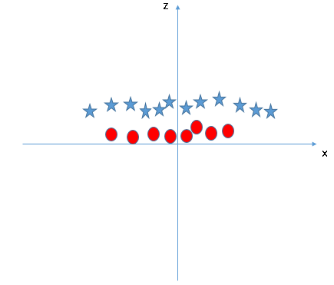
SVM can solve this problem. Easily! It solves this problem by introducing additional feature. Here, we will add a new feature z=x^2+y^2. Now, let’s plot the data points on axis

Slide 13
In above plot, points to consider are:
All values for z would be positive always because z is the squared sum of both x and y
In the original plot, red circles appear close to the origin of x and y axes, leading to lower value of z and star relatively away from the origin result to higher value of z.
In the SVM classifier, it is easy to have a linear hyper-plane between these two classes. But, another burning question which arises is, should we need to add this feature manually to have a hyper-plane. No, the SVM algorithm has a technique called the kernel trick. The SVM kernel is a function that takes low dimensional input space and transforms it to a higher dimensional space i.e. it converts not separable problem to separable problem. It is mostly useful in non-linear separation problem. Simply put, it does some extremely complex data transformations, then finds out the process to separate the data based on the labels or outputs you’ve defined.

Slide 14
Pros & Cons of Support Vector Machines
Pros
Accuracy
Works well on smaller cleaner datasets
It can be more efficient because it uses a subset of training points
Cons
Isn’t suited to larger datasets as the training time with SVMs can be high
Less effective on noisier datasets with overlapping classes
SVM Uses
SVM is used for text classification tasks such as category assignment, detecting spam and sentiment analysis. It is also commonly used for image recognition challenges, performing particularly well in aspect-based recognition and color-based classification. SVM also plays a vital role in many areas of handwritten digit recognition, such as postal automation services

